Slide 1
Virtual Museum
Patrick Asata
James Davidson
Samuel Famoyegun

Slide 2
A Virtual Museum
A museum with dynamic exhibits.
Current exhibits include a Planetarium, and a Jurassic Park.
Each exhibit is linked to an orb in the lobby of the museum.

Slide 3
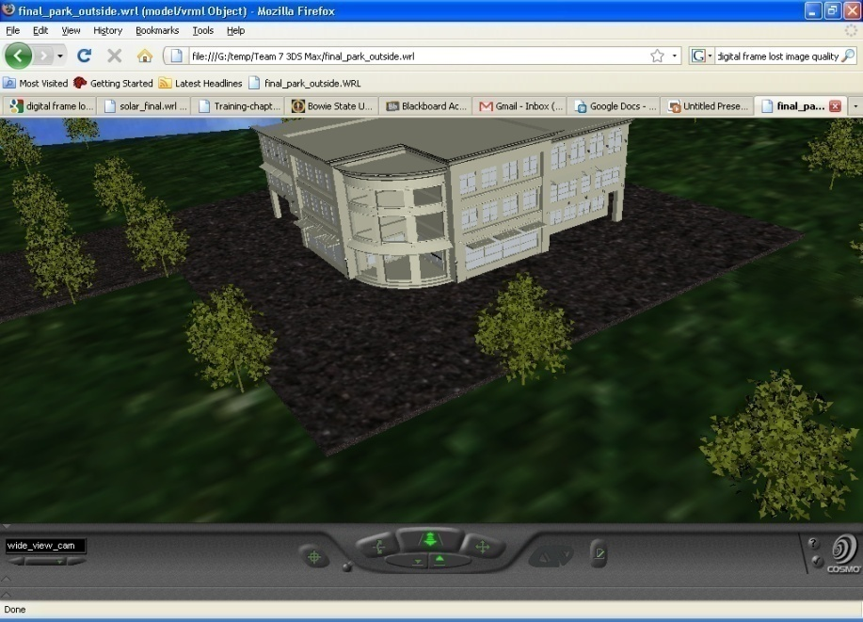
The Exterior
Features grassy planes, trees and an asphalt road
Building features two touch sensors
Two viewpoints

Slide 4
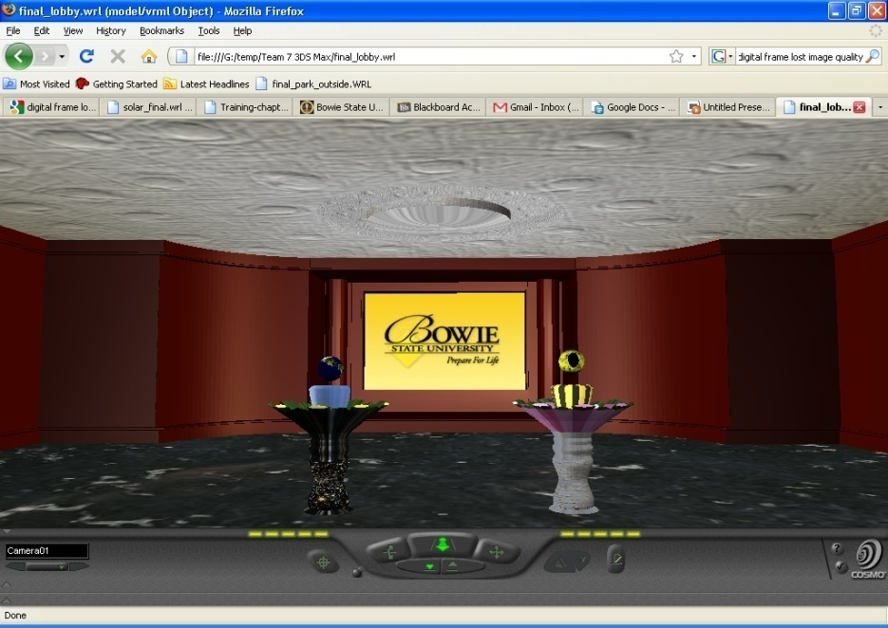
The Lobby
Each orb represents a link to an exhibit
Orbs can included/removed based on the status of exhibits
BSU logo functions as an exit

Slide 5
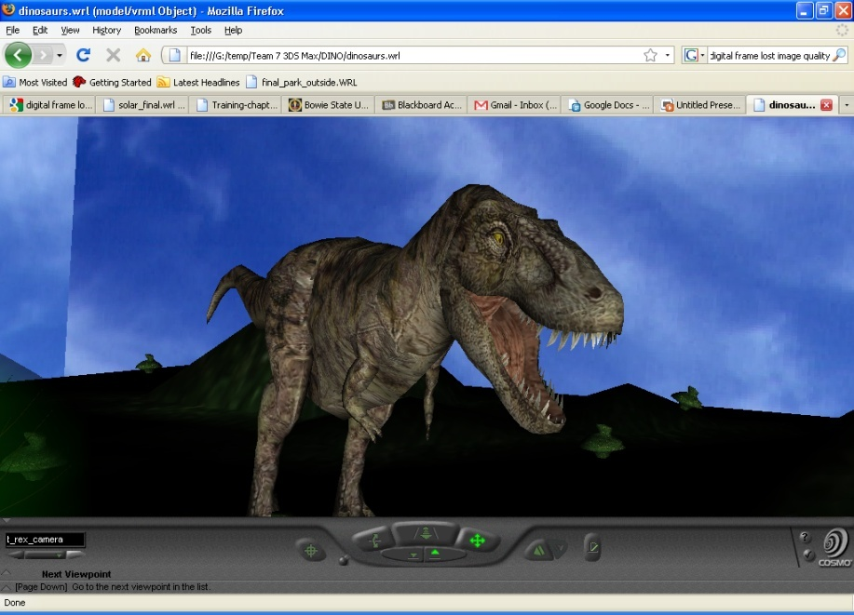
The Dinosaurs
Currently have 3 specimens
Each is anchored to a website.
There are links that take you back to the exhibits.

Slide 6
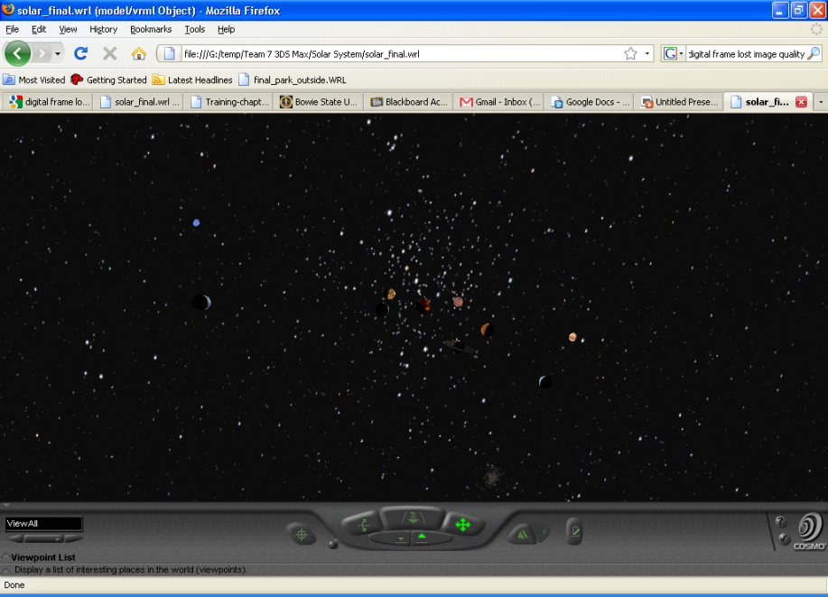
The Planetarium
Virtual model of our solar system
Each planet is linked to an external webpage

Slide 7
Lessons Learned
Creating background environments in VRML in lieu of 3DS Max
Alternatives to work around rendering problems in VRML
Limiting object complexity to reduce file sizes

